Slide 1

DESIGN IMPLEMENTATION DAY 2

Slide 2

Standup
How was yesterday?
What is your favourite hobby?
Barbara
Donald
Nicole
Javier
Gloria
Juliette
Michael
Emilia
Sukran
Suran
Lenny
Hassan
Berna
Amy
Ola
Milena
Miriam
Carolina
Gizem
Dave
Patrick
Tatiana

Slide 3
What is CSS
Cascading Style Sheets
What does Cascading mean?

Slide 4
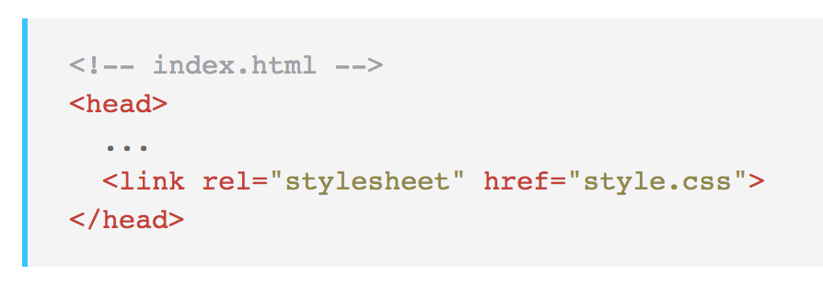
How can we link css file to html?

Slide 5
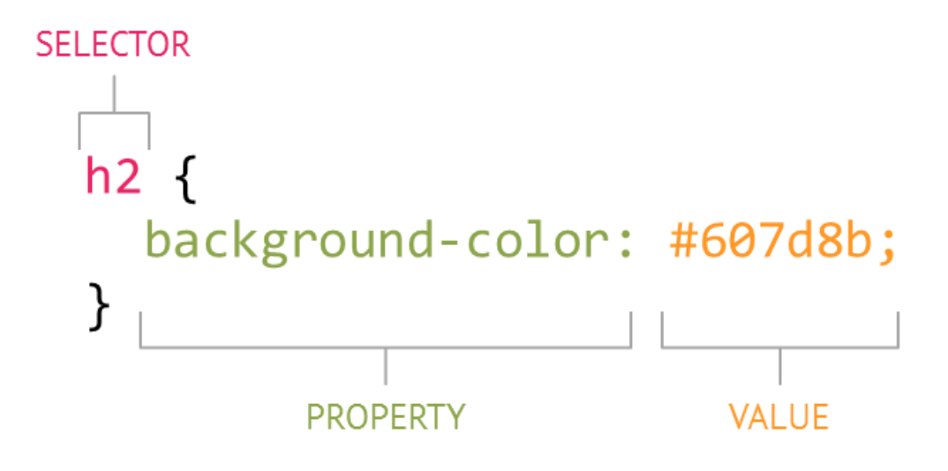
CSS Elements
Selector: Points to the element(s) that you will apply the style rule to.
Declaration block: Contains one or more declarations separated by semicolons.
These declarations specify the elements properties and the values you want to set

Slide 6
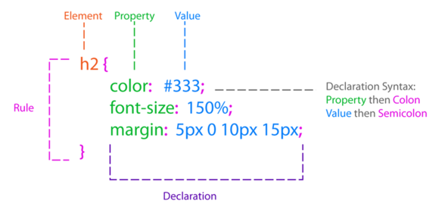
CSS Elements

Slide 7
Universal selector
* {
margin: 0;
padding: 0;
}

Slide 8
How can we target HTML elements?
By Tag
By Id
By Class

Slide 9
Tag selector
Tag Selectors match elements by their node name. In HTML, elements are the tags we add, for example <p>, <header> or <div>
div {
Background-color: #000000;
}

Slide 10
Class selector
In HTML and CSS, you can identify a group of HTML elements with the same characteristics or styles using a class attribute. The class is an attribute of the element(s) that you’re trying to change and requires a name.
.heading-css {
color: #ffffff;
}
Can add multiple class

Slide 11
ID selector
An ID Selector identifies a unique, unrepeatable element in the HTML. ID selectors match an element based on the content of that element’s ID attribute
Elements can and only have one ID.
#heading-main {
font-size: 1em;
}

Slide 12
id vs class
By Id
By Class
Id is a unique identifier:
Id is a unique identifier:
Single element => Single id
Ids should not be reused
Single element => Multiple classes
Classes can be reused

Slide 13
CSS order of priorities
1
Inline Style
2
ID
3
class
4
Element

Slide 14
html
body
header
nav
mian
img
div
input
img
h3
h1
p
button
img
p
footer
p

